Slide 1

Artificial Neural Network: Tensorflow, Keras & Architecture of Keras
Mina Farmanbar
Associate Professor, University of Stavanger
for engineers

Slide 2
What is Keras
It is a deep learning Application Programming Interface (API) that offers a simple, user-friendly way to define a neural network.
The framework supported by Keras is Tensorflow (The most famous symbolic math library )
To use Keras, we will need to have the TensorFlow package installed.
Once TensorFlow is installed, just import Keras via:
pip install TensorFlow
from tensorflow import keras

Slide 3
Architecture of Tensorflow
Uses
Modules
Activations
Optimizer
Sequential API
Functional API
Losses
Visualization
Model API
Metrics
Core Layer
Locally Connected Layer
Uses
Modules
Initializer
Convolution Layer
Recurrent Layer
Rigularizers
Pooling Layer
Layer API
Core Modules API

Slide 4
Architecture of Tensorflow
What type of neural network are we building ?
Sequential Model
Is basically a linear composition of Keras Layers.
In a sequential neural net, neurons are arranged in layers and in sequence.
Functional API
Is basically used to create complex models.
Sequential API
Functional API
Model API

Slide 5
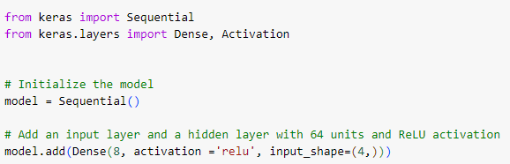
Architecture of Tensorflow
A simple sequential model is as follows:
The parameter input_shape is only used when creating the first layer.
input_shape = (4,), which is exactly the same as input_dim = 4

Slide 6
Architecture of Tensorflow
The actual shape of the input layer depends on the number of dimensions.
In the case of a one-dimensional array of n features, the input_shape looks like (batch_size, n).
input_shape = (batch_size, n)
We can skip the batch_size when we define the model structure, so in the code, we write:
input_shape = (4,)

Slide 7
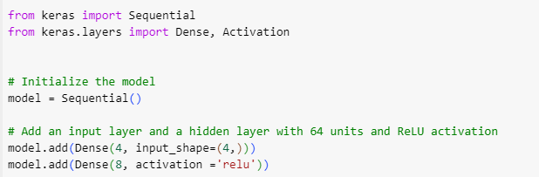
Architecture of Tensorflow
Also, can be written as:

Slide 8
Architecture of Tensorflow
Some of the important Keras layers are specified below:
Core Layer
Locally Connected Layer
Convolution Layer
Recurrent Layer
Pooling Layer
Layer API

Slide 9
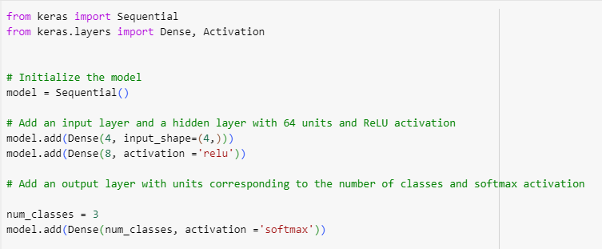
Architecture of Tensorflow
A simple python code to represent a neural network model using sequential model is as follows:

Slide 10
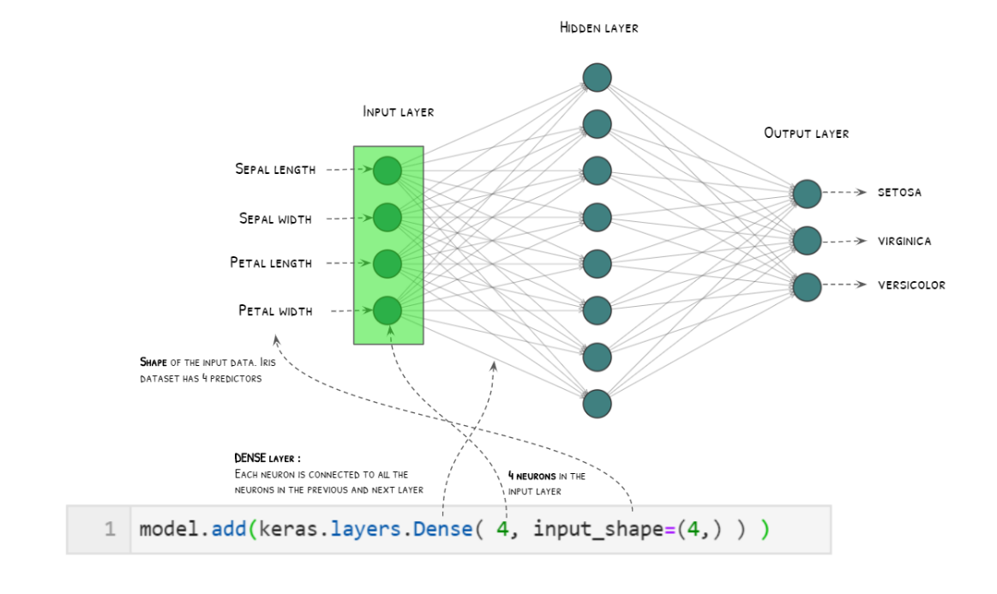
Architecture of Tensorflow
https://i0.wp.com/ajaytech.co/wp-content/uploads/2019/08/keras-input-layer-1.png?w=1146&ssl=1

Slide 11
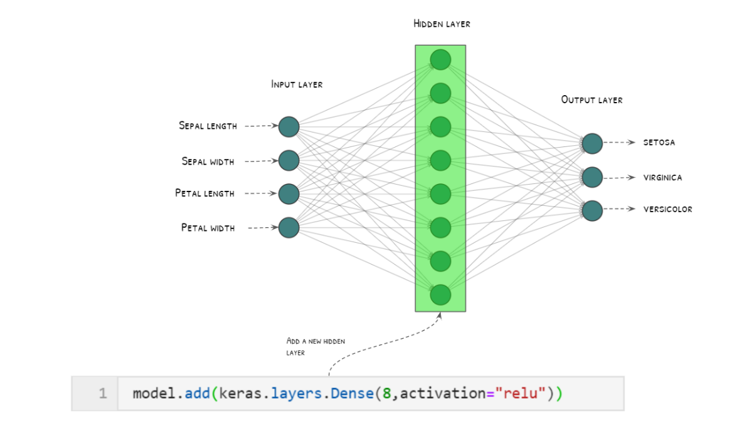
Architecture of Tensorflow
https://i0.wp.com/ajaytech.co/wp-content/uploads/2019/08/keras-input-layer-1.png?w=1146&ssl=1

Slide 12
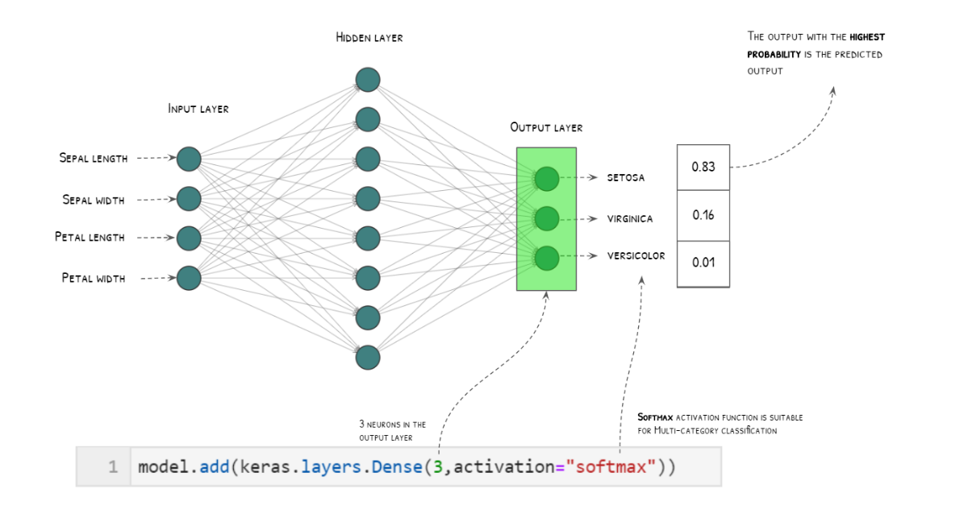
Architecture of Tensorflow
https://i0.wp.com/ajaytech.co/wp-content/uploads/2019/08/keras-input-layer-1.png?w=1146&ssl=1

Slide 13
Architecture of Keras (Core Modules)
Activations module:
Softmax, ReLU, etc.
Loss module:
Mean_squared_error, Mean_absolute_error, etc.
Optimizer module:
Adam, Sgd, etc.
Regularizers module:
L1 regularizer, L2 regularizer, etc.
Activations
Optimizer
Losses
Visualization
Metrics
Initializer
Rigularizers

Slide 14
Train the Model and use it forPredicting
Keras Model provides functions for training, evaluation and prediction process. They are as follows:
Compile
Configure the learning process of the model
Fit
Train the model using the training data
Evaluate
Evaluate the model using the test data
Predict
Predict the results for new input.

Slide 15
Compile
With the compile( ) method, Keras translates the parameters you have specified into an optimized series of steps that can then be executed on the computer.
Without the compile step, you cannot fit (train) the model.

Slide 16

Fit
The training process will run for a fixed number of iterations through the dataset called epochs, that we must specify using the epochs argument.
We can also set the number of instances that are evaluated before a weight update in the network is performed called the batch size and set using the batch size argument.

Slide 17

Evaluate the Model
Evaluate the model by predicting the output for test data and cross-comparing the prediction with actual result of the test data.

Slide 18
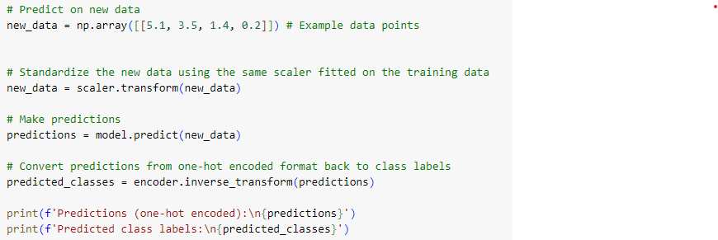
Architecture of Keras (layer)
Make Prediction
With the model trained, you can use it to make predictions.

Slide 19
Thank you!
Mina Farmanbar
mina.farmanbar@uis.no

